Slide 2
Bimzelx Patient Community Team Charter
Date Set:
Next Review:
Primary Task:
In Scope:
Out of Scope:
Characteristics of As-Is State:
Characteristics of To-Be State:
Our Leadership Behaviours we Commit to:
Team Commitments:
Success Measures:
Commitment Champions:
Signatures:

Slide 3
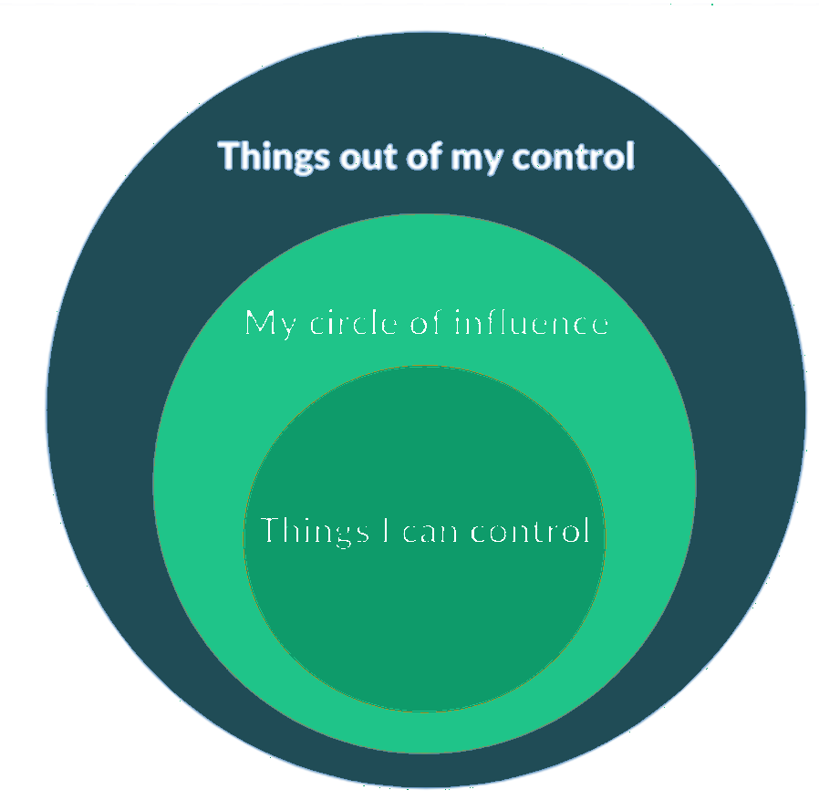
Bimzelx Patient Community Team Charter
Part 2: In Scope and Out of Scope
Consider What Needs to be In Scope and Out of Scope
to Set You Up for Success in 2026? (5 mins)
E.g.
In Scope:
Activities related to our 3-year strategy
Out of Scope:
The OPM (this was agreed in 2025)
Notes:
Opening spiel about teams who talk and feedback and how they become high-performing teams
Explain that this is designed to feel a little forced, but can help to aid rules around team discussion and feedback. Rules of the Fish on the Table: whoever holds it speaks; others listen; one short follow‑up allowed; no cross‑talk.

Slide 4
Bimzelx Patient Community Team Charter
Part 3: As-Is and To-Be
Consider these As-Is Statements and To-Be Statements we have taken from your team survey (10 mins). Does this do your team justice?
As-Is
Our work is genuinely strong: nobody questions delivery quality and when the patient view arrives early, it changes decisions.
We're just not yet harnessing our full strength as a team. Some stakeholders need to understand us better & we mostly convene when Catrinel pulls us together. Few of us can name a decision we made as a group.
Our primary task is clear on paper with opportunity to use it day to day.
Notes:
Opening spiel about teams who talk and feedback and how they become high-performing teams
Explain that this is designed to feel a little forced, but can help to aid rules around team discussion and feedback. Rules of the Fish on the Table: whoever holds it speaks; others listen; one short follow‑up allowed; no cross‑talk.

Slide 5
Bimzelx Patient Community Team Charter
Part 3: As-Is and To-Be
Consider these As-Is Statements and To-Be Statements we have taken from your team survey (10 mins). Does this do your team justice?
To-Be
We act as one team and not four functions working in parallel, coming together on our own initiative rather than only when convened.
Our primary task actively guides our work day-to-day, and we can name decisions we made together.
We seek out opportunities to communicate to stakeholders and the patient perspective is brought in early enough to shape the outcome rathe.
Notes:
Opening spiel about teams who talk and feedback and how they become high-performing teams
Explain that this is designed to feel a little forced, but can help to aid rules around team discussion and feedback. Rules of the Fish on the Table: whoever holds it speaks; others listen; one short follow‑up allowed; no cross‑talk.

Slide 6
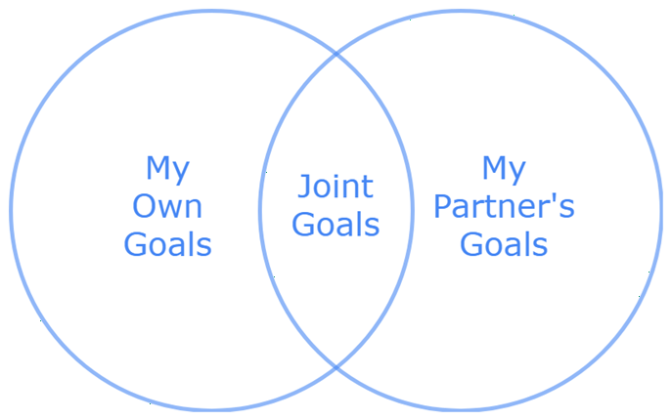
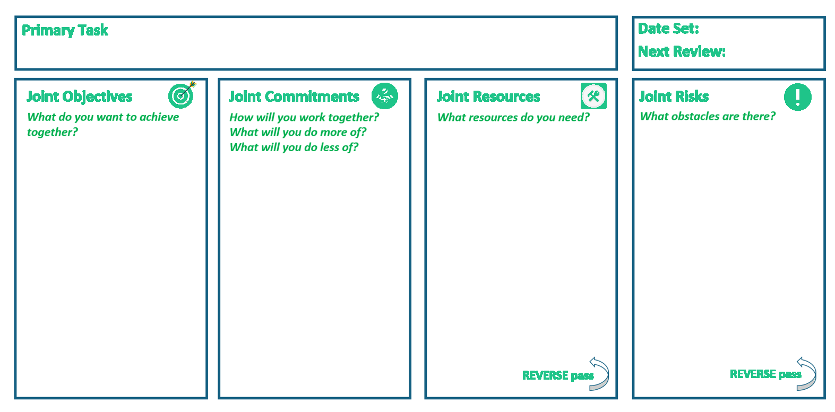
One Team Definition
Part 4: Joint Goal-Setting
We’re going to run a Team WoW Commitment Mapping exercise to agree your joint team goals and commitments and how to incorporate these into your everyday work, i.e. these will be your Ways of Working
Notes:
Opening spiel about teams who talk and feedback and how they become high-performing teams
Explain that this is designed to feel a little forced, but can help to aid rules around team discussion and feedback. Rules of the Fish on the Table: whoever holds it speaks; others listen; one short follow‑up allowed; no cross‑talk.

Slide 7







One Team Definition
FORWARD pass
REVERSE pass
REVERSE pass

Slide 8




Example Team WoW Commitment Map
Primary Task
Date Set:
Why do you want to agree team commitments? What will be different once you have?
September 2026
Next Review:
To empower countries to treat more patients than ever before and improve patient outcomes
January 2027
Joint Objectives
Joint Commitments
Joint Resources
Joint Risks
What do you want to achieve together?
How will you work together?
What will you do more of?
What will you do less of?
What resources do you need?
What obstacles are there?
Everyone knows their role in the team and what they can contribute
The Team agrees all feedback will be given in team meetings, unless it is of a personal nature
FORWARD pass
The team has agreed the best way to communicate
The team will only use Teams to communicate; emails will be kept to a minimum
We have no time as a team to give one another feedback properly
The team can collaborate and communicate freely, but are afraid to tackle conflicts
The team agrees not to let issues linger
Conflicts within the team will be addressed by the entire team
One hour of Cycle Meetings blocked out for feedback
REVERSE pass
REVERSE pass

Slide 9
Activity: Setting Team Goals
Using the Team Commitment Map:
In 2 separate groups, complete the forward and reverse pass of the Team Commitment map (30 mins)
As 1 group, present back and consolidate (15 mins).
Aim to have 3-5 Objectives and 5-7 Commitments

Slide 10
Team Commitment Map
1
2
xx
xx
xxx
xx
xx
xx
xx
xx

Slide 11
Bimzelx Patient Community Team Charter
Date Set:
Next Review:
Primary Task:
In Scope:
Out of Scope:
Characteristics of As-Is State:
Characteristics of To-Be State:
Our Leadership Behaviours we Commit to:
Team Commitments:
Success Measures:
Commitment Champions:
Signatures:

